Slide 1
Non-Invasive MRI of Blood–Cerebrospinal Fluid Barrier Function
Evans et al. Nature Communications 2020: https://doi.org/10.1038/s41467-020-16002-4

Slide 2
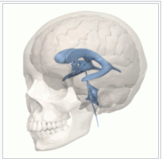
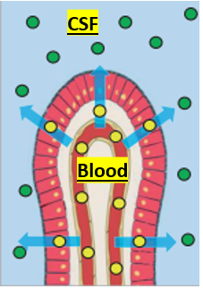
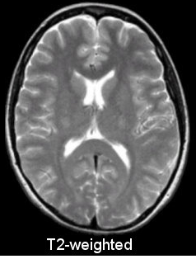
Blood Cerebral Spinal Fluid Barrier (BCSFB)
Background
Some molecules pass
From blood to ventricles (blue)
CSF removes waste buildup
Linked to Alzheimer’s
Mechanically protects brain
Lack of non-invasive imaging
Invasive is dangerous
Brightest signal in MRI T2-weighted image
BCSFB
Evans et al. Nature Communications 2020: https://doi.org/10.1038/s41467-020-16002-4
https://en.wikipedia.org/wiki/Ventricular_system
https://case.edu/med/neurology/NR/MRI%20Basics.htm

Slide 3
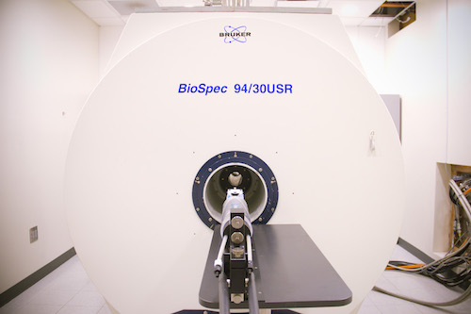
MRI
Background
Images water in vivo
Contrast from molecular environment
Water density
T1 decay
T2 decay – during image acquisition
Dangers
High magnetic field
Heat deposition
Can magnetically label blood for blood-brain barrier and BCSFB imaging
https://www.med.unc.edu/bric/camri/about-9-4t-mri/, 4/27/2021

Slide 4
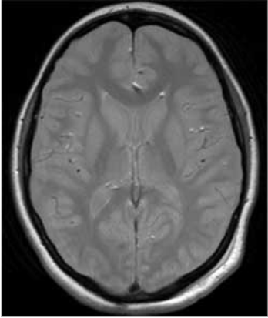
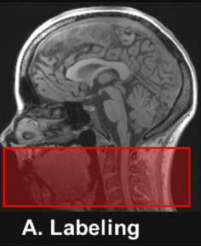
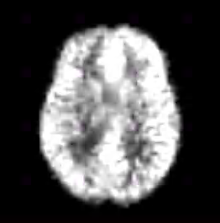
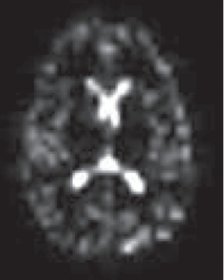
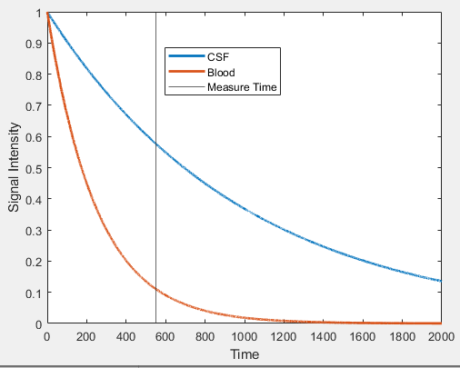
Arterial spin labeling
Methods
https://www.radiologycafe.com/radiology-trainees/frcr-physics-notes/t1-t2-and-pd-weighted-imaging
Ferre et al. Diagnostic cand Interventional Imaging 2013: https://doi.org/10.1016/j.diii.2013.06.010
Evans et al. Nature Communications 2020: https://doi.org/10.1038/s41467-020-16002-4
Suppress
signal
Label blood upstream
Image blood
Blood water flows into CSF via BCSFB
Signal decay vs time allows for CSF measurement
Image CSF?

Slide 5
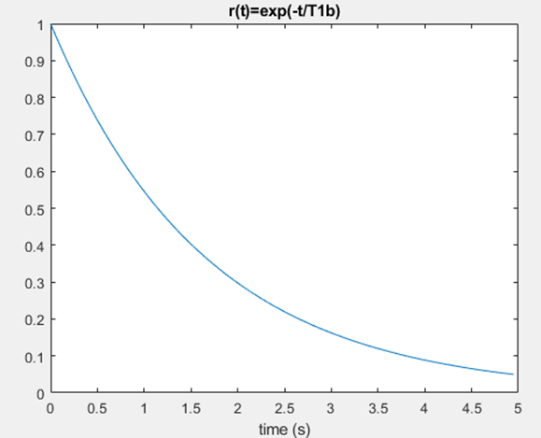
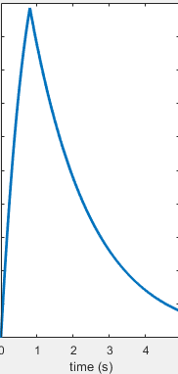

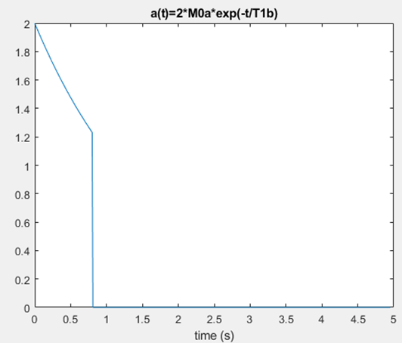
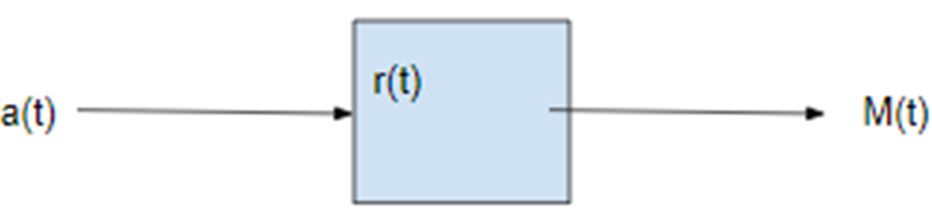
Kinetic model
Model based on Chappell et al. 2018
Methods
Quantification of blood flow and blood-to-CSF rate
Convolution of two functions:
Blood entering a voxel as its signal decays a(t)
Blood signal decay in voxel r(t)
Signal decay different in CSF and blood
a(t)
M(t)
r(t)

Slide 6
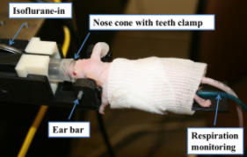
Sample Preparation
Zhang et al. Physics in Medicine and Biology 2014
DOI: 10.1088/0031-9155/59/5/1283
Methods
Mice for histology analysis
Mice anesthetized (isoflurane)
Respiration pillow for breathing rate
Temperature monitoring (heat deposition from radiation)
9.4T
Signal-to-noise proportional to field strength

Slide 7
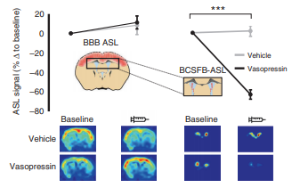
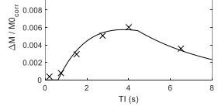
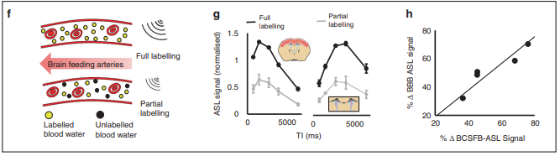
Validation
Results
BCSFB measurements fit model
Vasopressin injection decreases signal
Consistent with invasive findings
Partial labeling of blood decreases signal
Signal is coming from labeled blood
Evans et al. Nature Communications 2020: https://doi.org/10.1038/s41467-020-16002-4

Slide 8
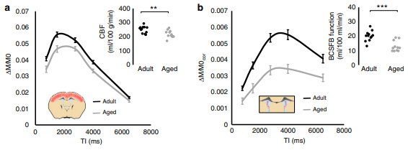
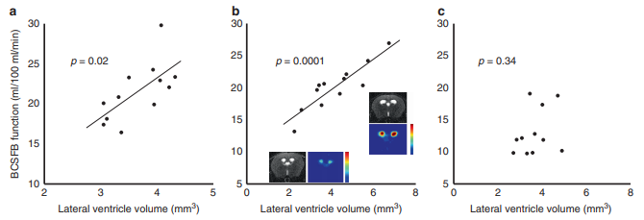
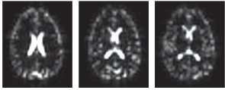
Validation
Results
In aged mice:
Blood flow decreases
BCSFB function decreases
Less water from blood to CSF
Higher rates of CSF creation does not increase ventricle size
Proof of concept in humans
3-month-old 6-month-old 23-month-old
Mean lifespan: 24 months
Evans et al. Nature Communications 2020: https://doi.org/10.1038/s41467-020-16002-4

Slide 9
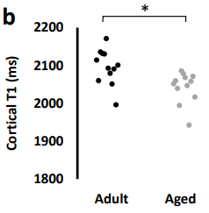
Critiques
Confounding factor with aging and perfusion
More calculations to determine significance?
Evans et al. Nature Communications 2020: https://doi.org/10.1038/s41467-020-16002-4

Slide 10
Acknowledgement
Thanks to the authors
Wikipedia for images
Beckman for blood flow image
Chappell et al. for description of kinetic model

